Slide 1
Database Systems
Chapter 4: Intermediate SQL
吴汉瑞 Hanrui Wu, Associated Professor
Email: wuhanrui@jnu.edu.cn
Research area: machine learning, artificial intelligence
Contact me if you are interested in research or would like to be my postgraduate

Slide 2
Chapter 4: Intermediate SQL
SQL Recap
Join Expressions
More on Views
Transactions
Integrity Constraints
SQL Data Types and Schemas
Authorization
Notes:
1

Slide 3
SQL Recap
DDL:
CREATE TABLE
PRIMARY KEY, FOREIGN KEY, NOT NULL, ON DELETE (NO ACTION, CASCADE, SET DEFAULT/NULL), CHECK, CONSTRAINT
DROP TABLE, ALTER TABLE
CREATE ASSERTION
CREATE VIEW
CREATE TRIGGER
DML
INSERT
DELETE
UPDATE
SELECT

Slide 4
SQL Recap (Cont.)
Basis SELECT, multi-relation queries and aliases
Set and bag operations
UNION, INTERSECT, …
Nested queries and unnesting
Set comparison operators
IN, EXISTS, ALL, ANY…
Aggregates
AVG, COUNT, SUM, …
NULL and ternary logic

Slide 5


Recap: Basic SELECT
SELECT [DISTINCT] target-list
FROM relation-list
[WHERE condition];
SELECT *
Arithmetic expressions
LIKE
ORDER BY
LIMIT, OFFSET

Slide 6
Recap: Multi-relation Queries
General form
Natural language semantics
Start with the Cartesian product R1×R2×…×Rn
Apply the selection conditions from the WHERE clause
Project the results onto a1,a2,…,ak
SELECT a1, a2, …, ak
FROM R1 AS x1, R2 AS x2, …, Rn AS xn
WHERE <conditions>;

Slide 7
Recap: Aggregates
SELECT [DISTINCT] target-list
FROM relation-list
[WHERE condition]
GROUP BY grouping-list
[HAVING group-condition];
target-list may contain from grouping-list and/or any aggregates, but no other attributes
condition may contain conditions on any attributes in relation-list
group-condition may contain conditions on aggregate expressions

Slide 8
Joined Relations
Join operations take two relations and return as a result another relation.
A join operation is a Cartesian product which requires that tuples in the two relations match (under some condition). It also specifies the attributes that are present in the result of the join
The join operations are typically used as subquery expressions in the from clause

Slide 9
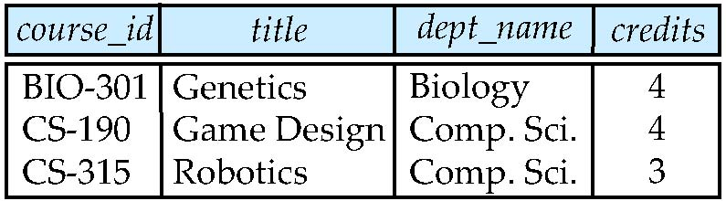
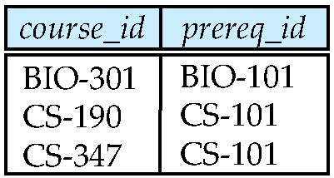
Join operations – Example
Relation course
Relation prereq
Observe that
prereq information is missing for CS-315 and
course information is missing for CS-347

Slide 10
Outer Join
An extension of the join operation that avoids loss of information.
Computes the join and then adds tuples form one relation that does not match tuples in the other relation to the result of the join.
Uses null values.

Slide 11
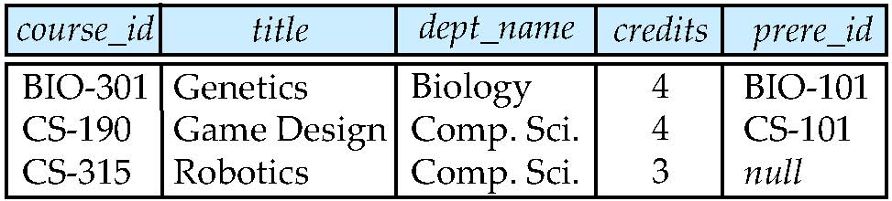
Left Outer Join
course natural left outer join prereq

Slide 12
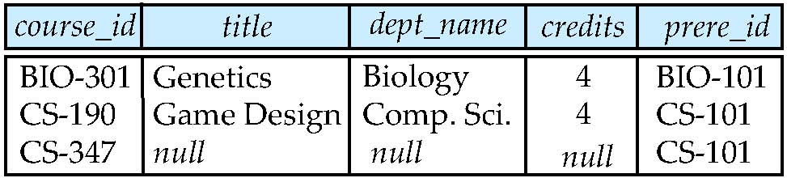
Right Outer Join
course natural right outer join prereq

Slide 13
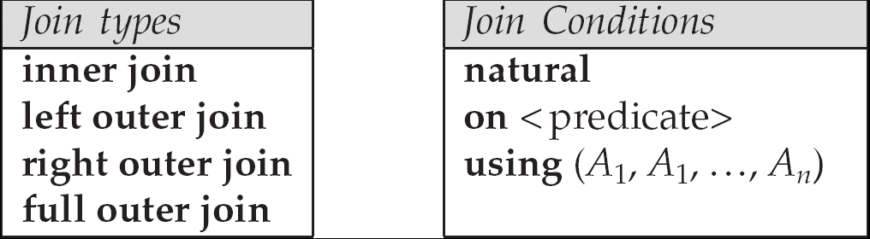
Joined Relations
Join operations take two relations and return as a result another relation.
These additional operations are typically used as subquery expressions in the from clause
Join condition – defines which tuples in the two relations match, and what attributes are present in the result of the join.
Join type – defines how tuples in each relation that do not match any tuple in the other relation (based on the join condition) are treated.

Slide 14
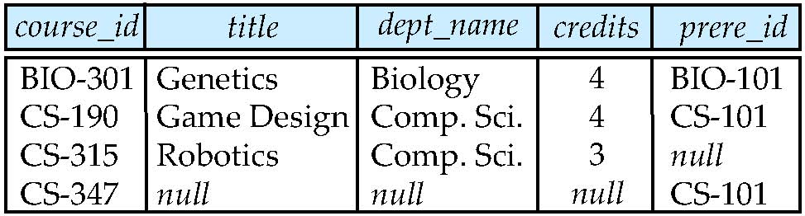
Full Outer Join
course natural full outer join prereq

Slide 15
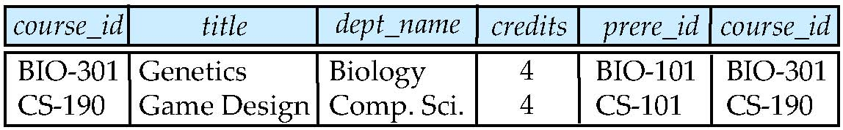
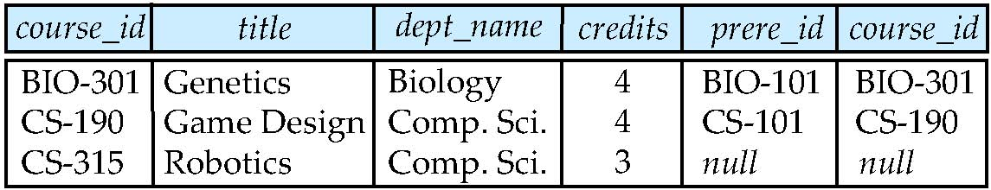
Joined Relations – Examples
course inner join prereq on course.course_id = prereq.course_id
What is the difference between the above, and a natural join?
course left outer join prereq on course.course_id = prereq.course_id

Slide 16
Joined Relations – Examples
course natural right outer join prereq
course full outer join prereq using (course_id)

Slide 17
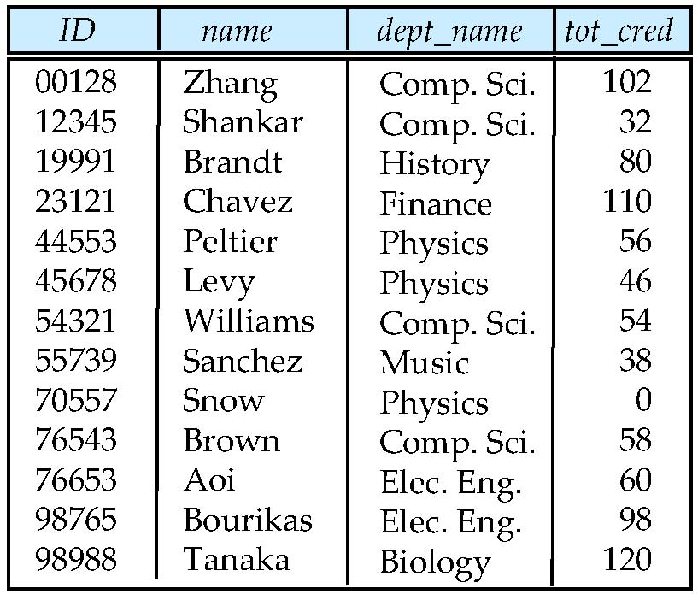
Fig. 4.1 The student relation

Slide 18
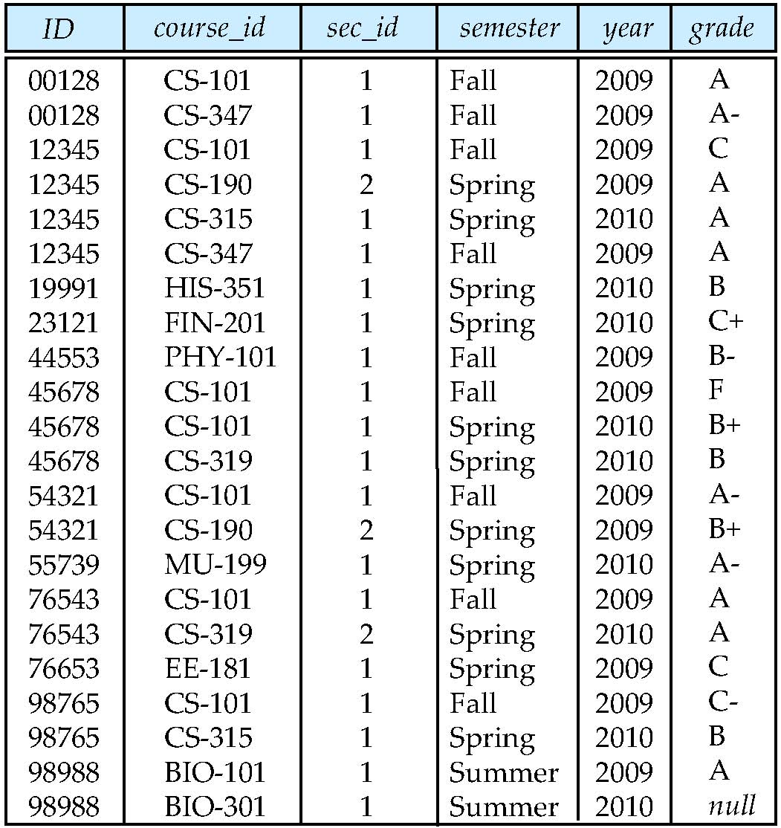
Fig. 4.2 The takes relation

Slide 19
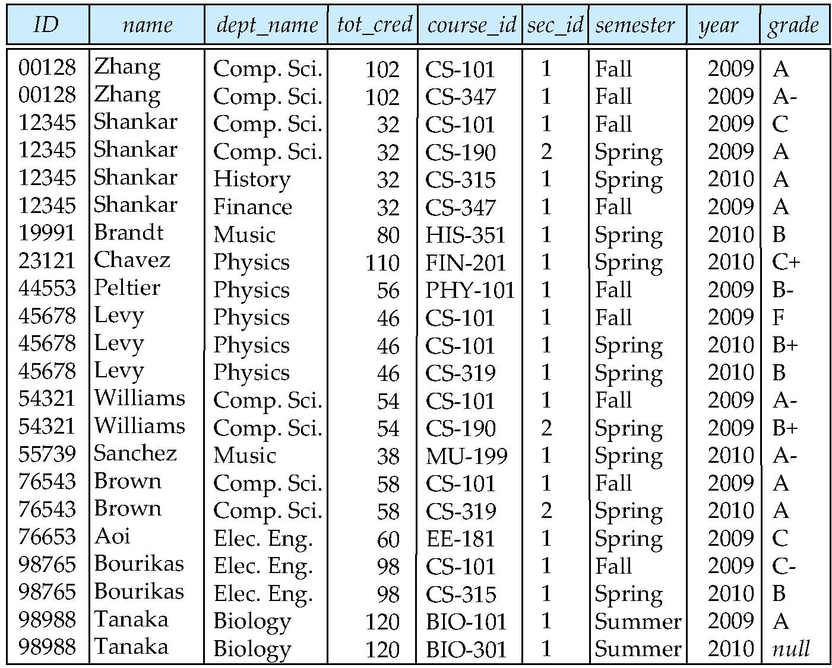
Fig. 4.3 The result of student join takes on student.ID= takes.ID with second occurrence of ID omitted

Slide 20
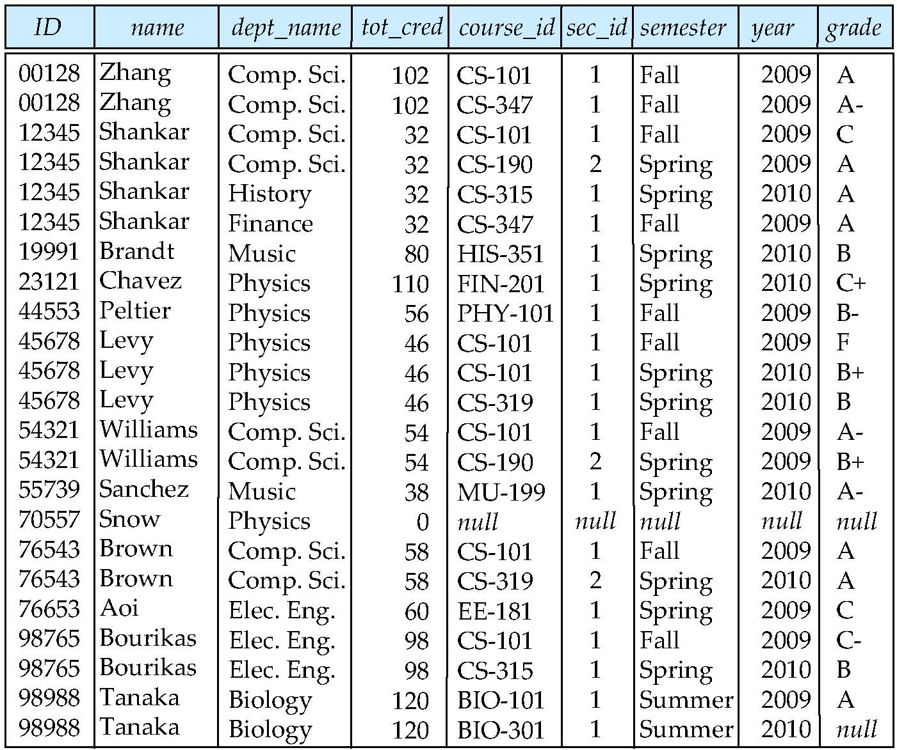
Fig. 4.4 Result of student natural left outer join takes

Slide 21
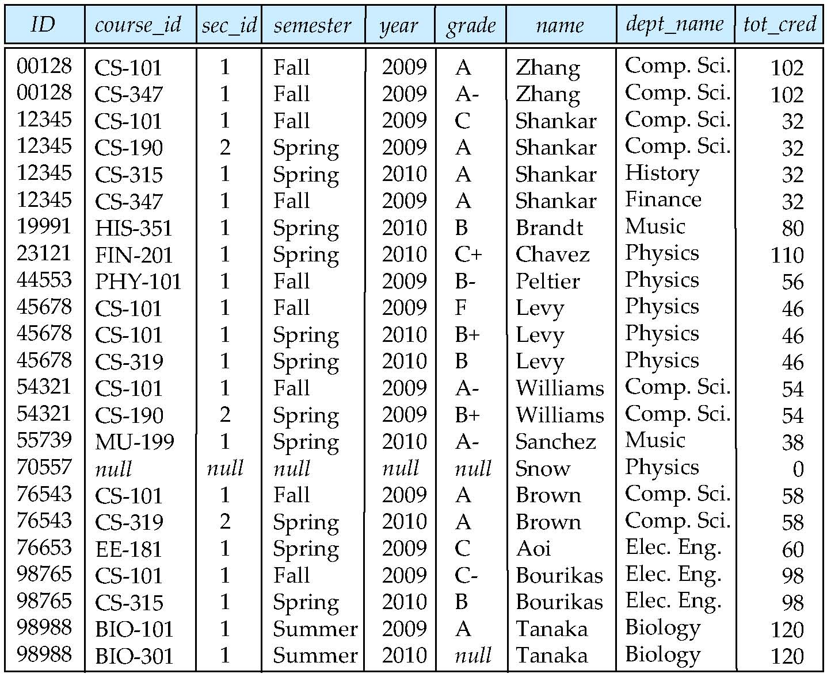
Fig. 4.5 Result of takes natural right outer join student

Slide 22
Views
In some cases, it is not desirable for all users to see the entire logical model (that is, all the actual relations stored in the database.)
Consider a person who needs to know an instructors name and department, but not the salary. This person should see a relation described, in SQL, by select ID, name, dept_name from instructor
A view provides a mechanism to hide certain data from the view of certain users.
Any relation that is not of the conceptual model but is made visible to a user as a “virtual relation” is called a view.

Slide 23
More on Views : Definition
A view is defined using the create view statement which has the form
create view v as <query expression>
where <query expression> is any legal SQL expression. The view name is represented by v.
Once a view is defined, the view name can be used to refer to the virtual relation that the view generates.
View definition is not the same as creating a new relation by evaluating the query expression
Rather, a view definition causes the saving of an expression; the expression is substituted into queries using the view.

Slide 24
Example Views
A view of instructors without their salary create view faculty as select ID, name, dept_name from instructor
Find all instructors in the Biology department select name from faculty where dept_name = ‘Biology’
Create a view of department salary totals
create view departments_total_salary (
dept_name, total_salary
) as select dept_name, sum(salary) from instructor group by dept_name;

Slide 25
Views Defined Using Other Views
create view physics_fall_2009 as select course.course_id, sec_id, building, room_number from course, section where course.course_id = section.course_id and course.dept_name = ’Physics’ and section.semester = ’Fall’ and section.year = ’2009’;
create view physics_fall_2009_watson as select course_id, room_number from physics_fall_2009 where building= ’Watson’;

Slide 26
View Expansion
Expand use of a view in a query/another view
create view physics_fall_2009_watson as
select course_id, room_number
from (select course.course_id, building, room_number
from course, section
where course.course_id = section.course_id
and course.dept_name = ’Physics’
and section.semester = ’Fall’
and section.year = ’2009’)
where building = ’Watson’;

Slide 27
Views Defined Using Other Views
One view may be used in the expression defining another view
A view relation v₁ is said to depend directly on a view relation v₂ if v₂ is used in the expression defining v₁
A view relation v₁ is said to depend on view relation v₂ if either v₁ depends directly to v₂ or there is a path of dependencies from v₁ to v₂
A view relation v is said to be recursive if it depends on itself.

Slide 28
View Expansion
A way to define the meaning of views defined in terms of other views.
Let view v₁ be defined by an expression e₁ that may itself contain uses of view relations.
View expansion of an expression repeats the following replacement step:
repeat Find any view relation v_{i} in e₁ Replace the view relation v_{i} by the expression defining v_{i}
until no more view relations are present in e₁
As long as the view definitions are not recursive, this loop will terminate

Slide 29
Update of a View
Add a new tuple to faculty view which we defined earlier
insert into faculty values (’30765’, ’Green’, ’Music’);
This insertion must be represented by the insertion of the tuple
(’30765’, ’Green’, ’Music’, null)
into the instructor relation

Slide 30
Some Updates cannot be Translated Uniquely
create view instructor_info as select ID, name, building from instructor, department where instructor.dept_name = department.dept_name;
insert into instructor_info
values (’69987’, ’White’, ’Taylor’);
which department, if multiple departments in Taylor?
what if no department is in Taylor?
Most SQL implementations allow updates only on simple views
The from clause has only one database relation.
The select clause contains only attribute names of the relation, and does not have any expressions, aggregates, or distinct specification.
Any attribute not listed in the select clause can be set to null
The query does not have a group by or having clause.

Slide 31
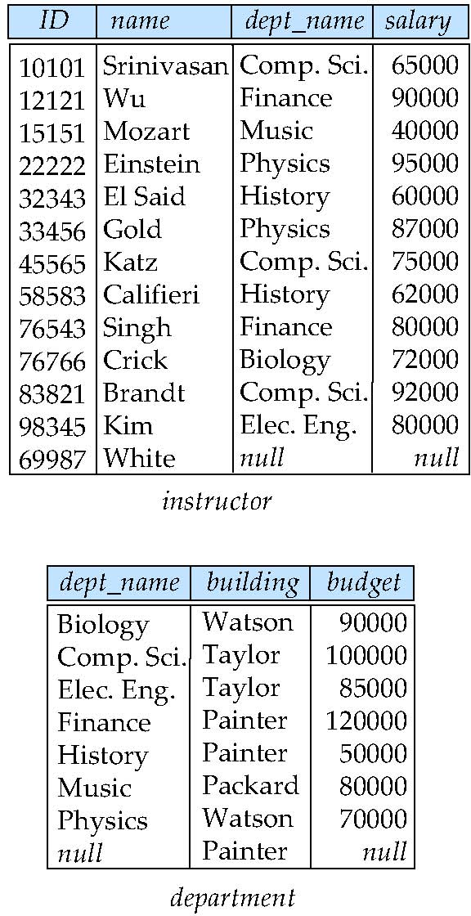
Fig. 4.7 Relations instructor and department after insertion of tuples
create view instructor_info as
select ID, name, building
from instructor, department
where instructor.dept_name =
department.dept_name;
This view lists the ID, name, and building-name of each instructor in the university.
Consider the following insertion through this view:
insert into instructor_info
values (’69987’, ’White’, ’Taylor’);
Taylor

Slide 32
Integrity Constraints
Integrity constraints guard against accidental damage to the database, by ensuring that authorized changes to the database do not result in a loss of data consistency.
A checking account must have a balance greater than $10,000.00
A salary of a bank employee must be at least $4.00 an hour
A customer must have a (non-null) phone number

Slide 33
Integrity Constraints on a Single Relation
not null
primary key
unique
check (P), where P is a predicate

Slide 34
Not Null and Unique Constraints
not null
Declare name and budget to be not null
name varchar(20) not null budget numeric(12,2) not null
unique ( A₁, A₂, …, A_{m})
The unique specification states that the attributes A1, A2, … Am form a candidate key.
Candidate keys are permitted to be null (in contrast to primary keys).

Slide 35
The check clause
check (P)
where P is a predicate
Example: ensure that semester is one of fall, winter, spring or summer:
create table section (
course_id varchar(8),
sec_id varchar(8),
semester varchar(6),
year numeric(4,0),
building varchar(15),
room_number varchar(7),
time_slot_id varchar(4),
primary key (course_id, sec_id, semester, year),
check (semester in (’Fall’, ’Winter’, ’Spring’, ’Summer’)) );

Slide 36
Referential Integrity
Ensures that a value that appears in one relation for a given set of attributes also appears for a certain set of attributes in another relation.
Example: If “Biology” is a department name appearing in one of the tuples in the instructor relation, then there exists a tuple in the department relation for “Biology”.
Let A be a set of attributes. Let R and S be two relations that contain attributes A and where A is the primary key of S. A is said to be a foreign key of R if for any values of A appearing in R these values also appear in S.

Slide 37
Cascading Actions in Referential Integrity
create table course ( course_id char(5) primary key, title varchar(20), dept_name varchar(20) references department )
create table course ( … dept_name varchar(20), foreign key (dept_name) references department on delete cascade on update cascade, . . . )
alternative actions to cascade: set null, set default

Slide 38
Built-in Data Types in SQL
date: Dates, containing a (4 digit) year, month and date
Example: date ‘2005-7-27’
time: Time of day, in hours, minutes and seconds.
Example: time ‘09:00:30’ time ‘09:00:30.75’
timestamp: date plus time of day
Example: timestamp ‘2005-7-27 09:00:30.75’
interval: period of time
Example: interval ‘1’ day
Subtracting a date/time/timestamp value from another gives an interval value
Interval values can be added to date/time/timestamp values

Slide 39
Index Creation
create table student ( ID varchar (5), name varchar (20) not null, dept_name varchar (20), tot_cred numeric (3,0) default 0, primary key (ID) )
create index studentID_index on student(ID)
Indices are data structures used to speed up access to records with specified values for index attributes
e.g. select * from student where ID = ‘12345’
can be executed by using the index to find the required record, without looking at all records of student
More on indices in Chapter 11

Slide 40
User-Defined Types
create type construct in SQL creates user-defined type
create type Dollars as numeric(12,2) final
create table department ( dept_name varchar(20), building varchar(15), budget Dollars
);

Slide 41
Domains
create domain construct in SQL-92 creates user-defined domain types
create domain person_name char(20) not null
Types and domains are similar. Domains can have constraints, such as not null, specified on them.
create domain degree_level varchar(10) constraint degree_level_test check (value in (’Bachelors’, ’Masters’, ’Doctorate’));

Slide 42
Large-Object Types
Large objects (photos, videos, CAD files, etc.) are stored as a large object:
blob: binary large object -- object is a large collection of uninterpreted binary data (whose interpretation is left to an application outside of the database system)
clob: character large object -- object is a large collection of character data
When a query returns a large object, a pointer is returned rather than the large object itself.

Slide 43
Authorization
Forms of authorization on parts of the database:
Read - allows reading, but not modification of data.
Insert - allows insertion of new data, but not modification of existing data.
Update - allows modification, but not deletion of data.
Delete - allows deletion of data.
Forms of authorization to modify the database schema
Index - allows creation and deletion of indices.
Resources - allows creation of new relations.
Alteration - allows addition or deletion of attributes in a relation.
Drop - allows deletion of relations.

Slide 44
Authorization Specification in SQL
The grant statement is used to confer authorization
grant <privilege list>
on <relation name or view name> to <user list>
<user list> is:
a user-id
public, which allows all valid users the privilege granted
A role (more on this later)
Granting a privilege on a view does not imply granting any privileges on the underlying relations.
The grantor of the privilege must already hold the privilege on the specified item (or be the database administrator).

Slide 45
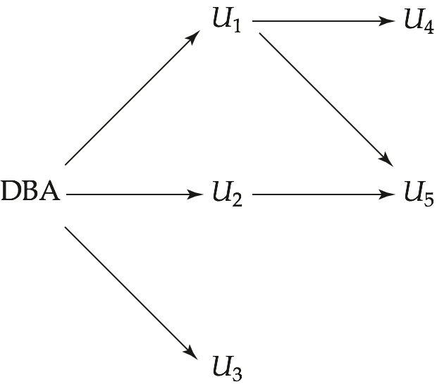
Fig. 4.10 Authorization-grant graph (U1,U2, . . . ,U5 are users and DBA refers to the database administrator)

Slide 46
Privileges in SQL
select: allows read access to relation,or the ability to query using the view
Example: grant users U₁, U₂, and U₃ select authorization on the instructor relation:
grant select on instructor to U₁, U₂, U₃
insert: the ability to insert tuples
update: the ability to update using the SQL update statement
delete: the ability to delete tuples.
all privileges: used as a short form for all the allowable privileges

Slide 47
Revoking Authorization in SQL
The revoke statement is used to revoke authorization.
revoke <privilege list>
on <relation name or view name> from <user list>
Example:
revoke select on branch from U₁, U₂, U₃
<privilege-list> may be all to revoke all privileges the revokee may hold.
If <revokee-list> includes public, all users lose the privilege except those granted it explicitly.
If the same privilege was granted twice to the same user by different grantees, the user may retain the privilege after the revocation.
All privileges that depend on the privilege being revoked are also revoked.

Slide 48
Roles
create role instructor;
grant instructor to Amit;
Privileges can be granted to roles:
grant select on takes to instructor;
Roles can be granted to users, as well as to other roles
create role teaching_assistant
grant teaching_assistant to instructor;
Instructor inherits all privileges of teaching_assistant
Chain of roles
create role dean;
grant instructor to dean;
grant dean to Satoshi;

Slide 49
End of Chapter 4

